Slide 1


filter buddy
Designing Word Filter Tools for Creator-led Comment Moderation
Shagun Jhaver, Quanze Chen,
Detlef Knauss, Amy Zhang

Slide 2
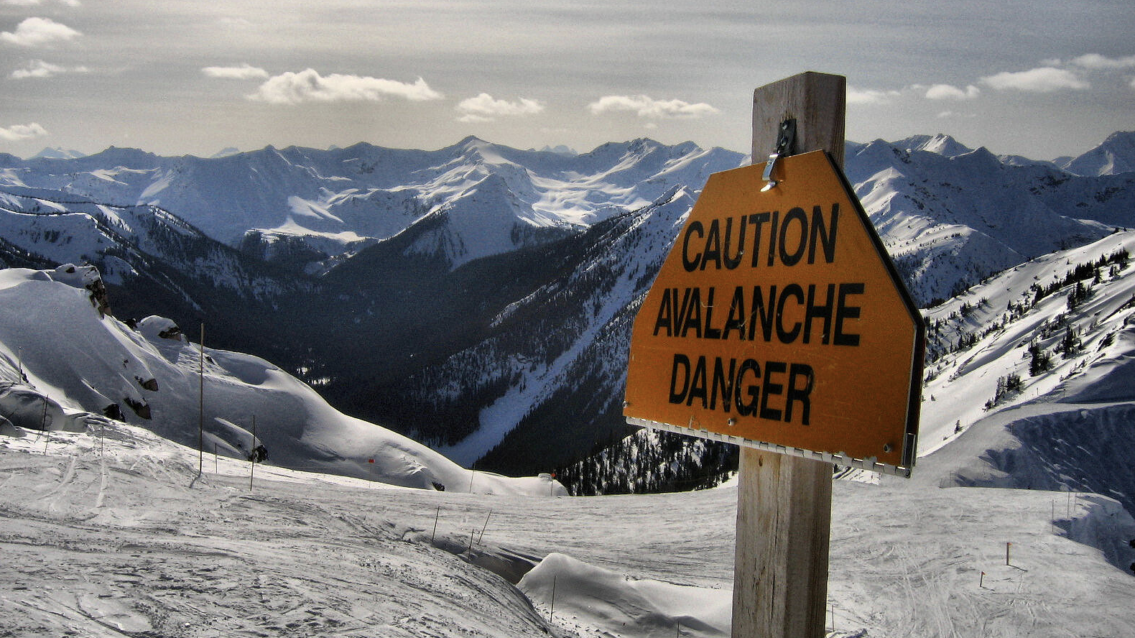
Caution: disturbing content
Notes:
Before I begin, I want to caution that some of the slides in this talk contain offensive language

Slide 3
Background
Notes:
Let me begin by providing some background for this work.

Slide 4

Content Creators
Notes:
This research is focused on serving content creators on platforms like YouTube, TikTok and Twitch.
Creators on these platforms not only have to write, produce and edit their content, they are also responsible for removing inappropriate comments posted on their channels.

Slide 5
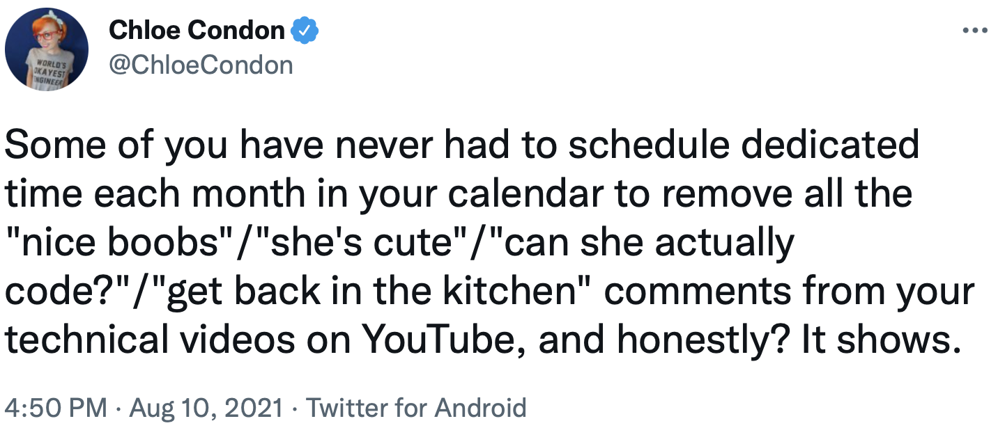
Notes:
Creators, esp. those belonging to marginalized groups, often experience stalking, harassment and online threats and feel a need to engage in comment moderation.
But as their channels grow, it becomes difficult for creators to review all their comments by themselves, and some automation becomes necessary.
As a result, creators have long requested for powerful moderation tools that can reduce their workload.

Slide 6
Goals
Investigate the design of moderation tools
Esp. creators from marginalized groups
Surface unmet information needs
Build a system that addresses these needs
Evaluate what we built
Notes:
Given this context, the goals of this research were to investigate the design of moderation tools aimed at content creators.
We focused especially on creators belonging to marginalized groups, because they face disproportionate harassment.
Through this investigation, we wanted to surface the unmet information and moderation needs of content creators.
Next, we wanted to build a system that begins to address these needs.
And finally, we wanted to evaluate what we built to inform the future design of automated moderation systems.

Slide 7
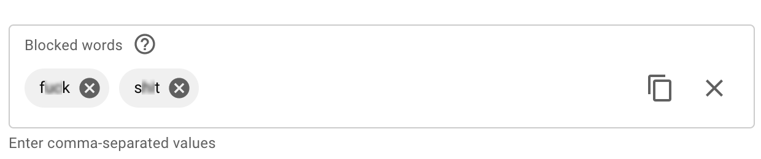
Word filter tool on YouTube
Notes:
As creators, one of the most commonly available tools to automate moderation is word filters.
These are tools in which users can configure a list of phrases and comments containing any of those phrases are automatically removed.

Slide 8
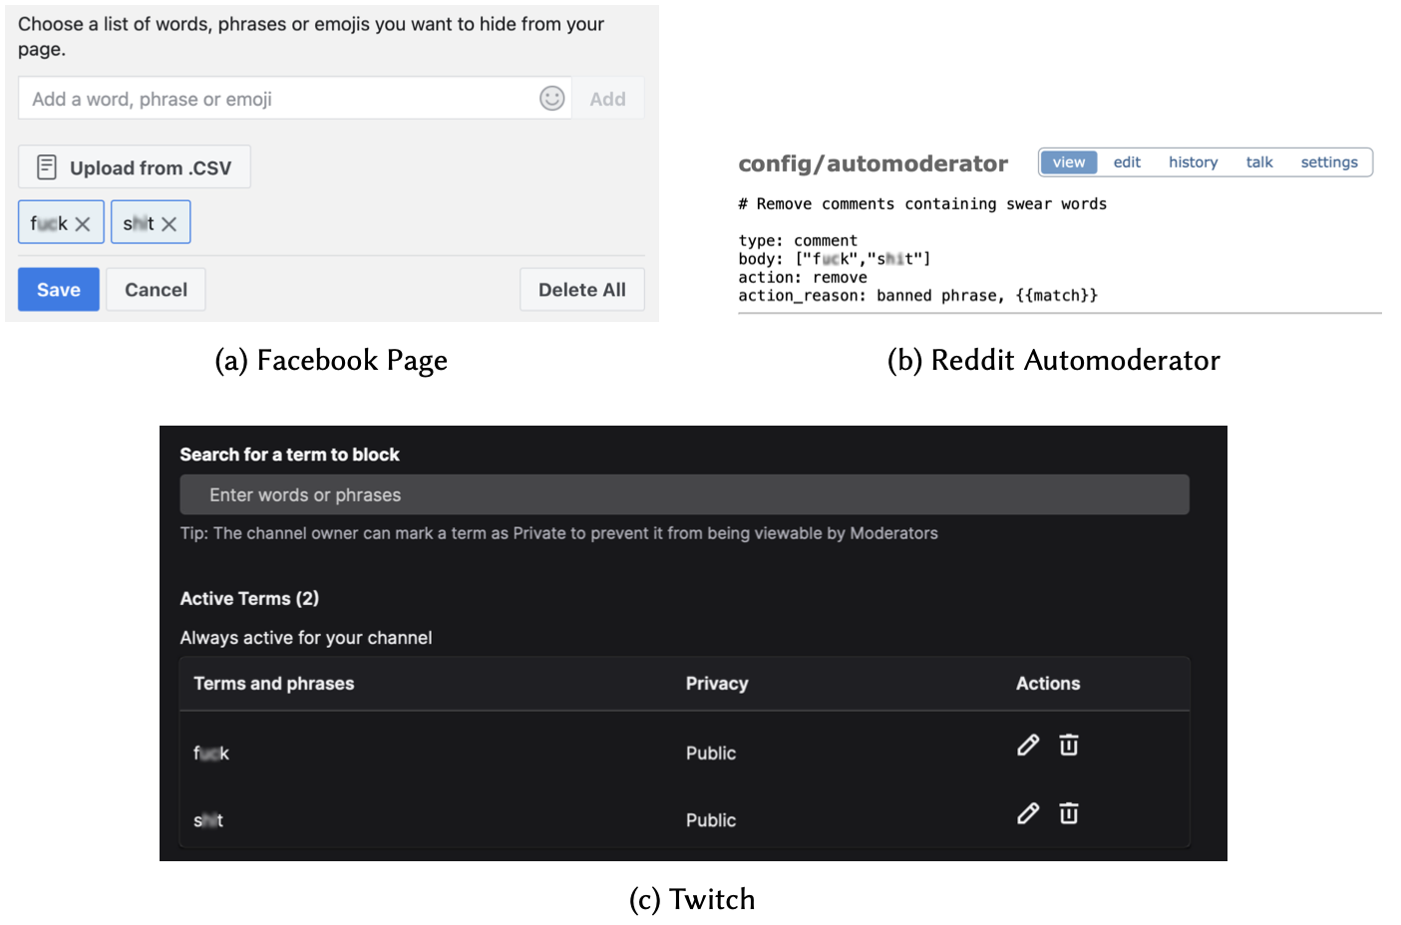
Word filter tools
Notes:
While these word filter tools are available on many platforms like YouTube, Facebook, Reddit and Twitch, they usually present very rudimentary features.
So, in this study, we focus our need-finding and design exploration around word filter tools.

Slide 9
Need-finding & System design
Notes:
We first identified the moderation needs of creators who use word filter tools

Slide 10
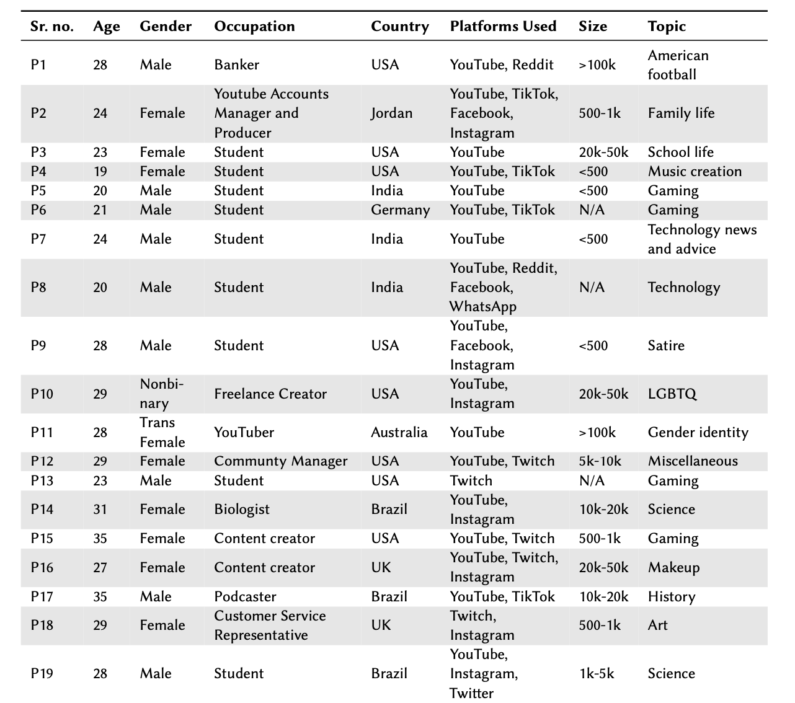
Need-finding
Notes:
For this, we interviewed 19 creators who use word filter tools on YouTube, Twitch or TikTok, and analyzed our interview data using interpretive qualitative analysis.

Slide 11


Need-finding interviews
System Features
Creators’ Needs
filter buddy
Notes:
Through these interviews, we identified creators’ needs and then built a new system called FitlerBuddy, that
augments word filter tools with features to support better authoring, maintenance, and auditing of word filters.
To begin with, we have implemented FilterBuddy for YouTube.
Next, let me discuss how FilterBuddy features address the specific needs of creators

Slide 12
Need 1: Separately group different categories of inappropriate comments
Better organization
Easier review and search
Notes:
During our needs analysis, our participants told us that instead of a single box to configure all their word filters, they wanted to separately group different categories of inappropriate comments because it would lead to better organization of their word filters and allow an easier review and search for them.

Slide 13
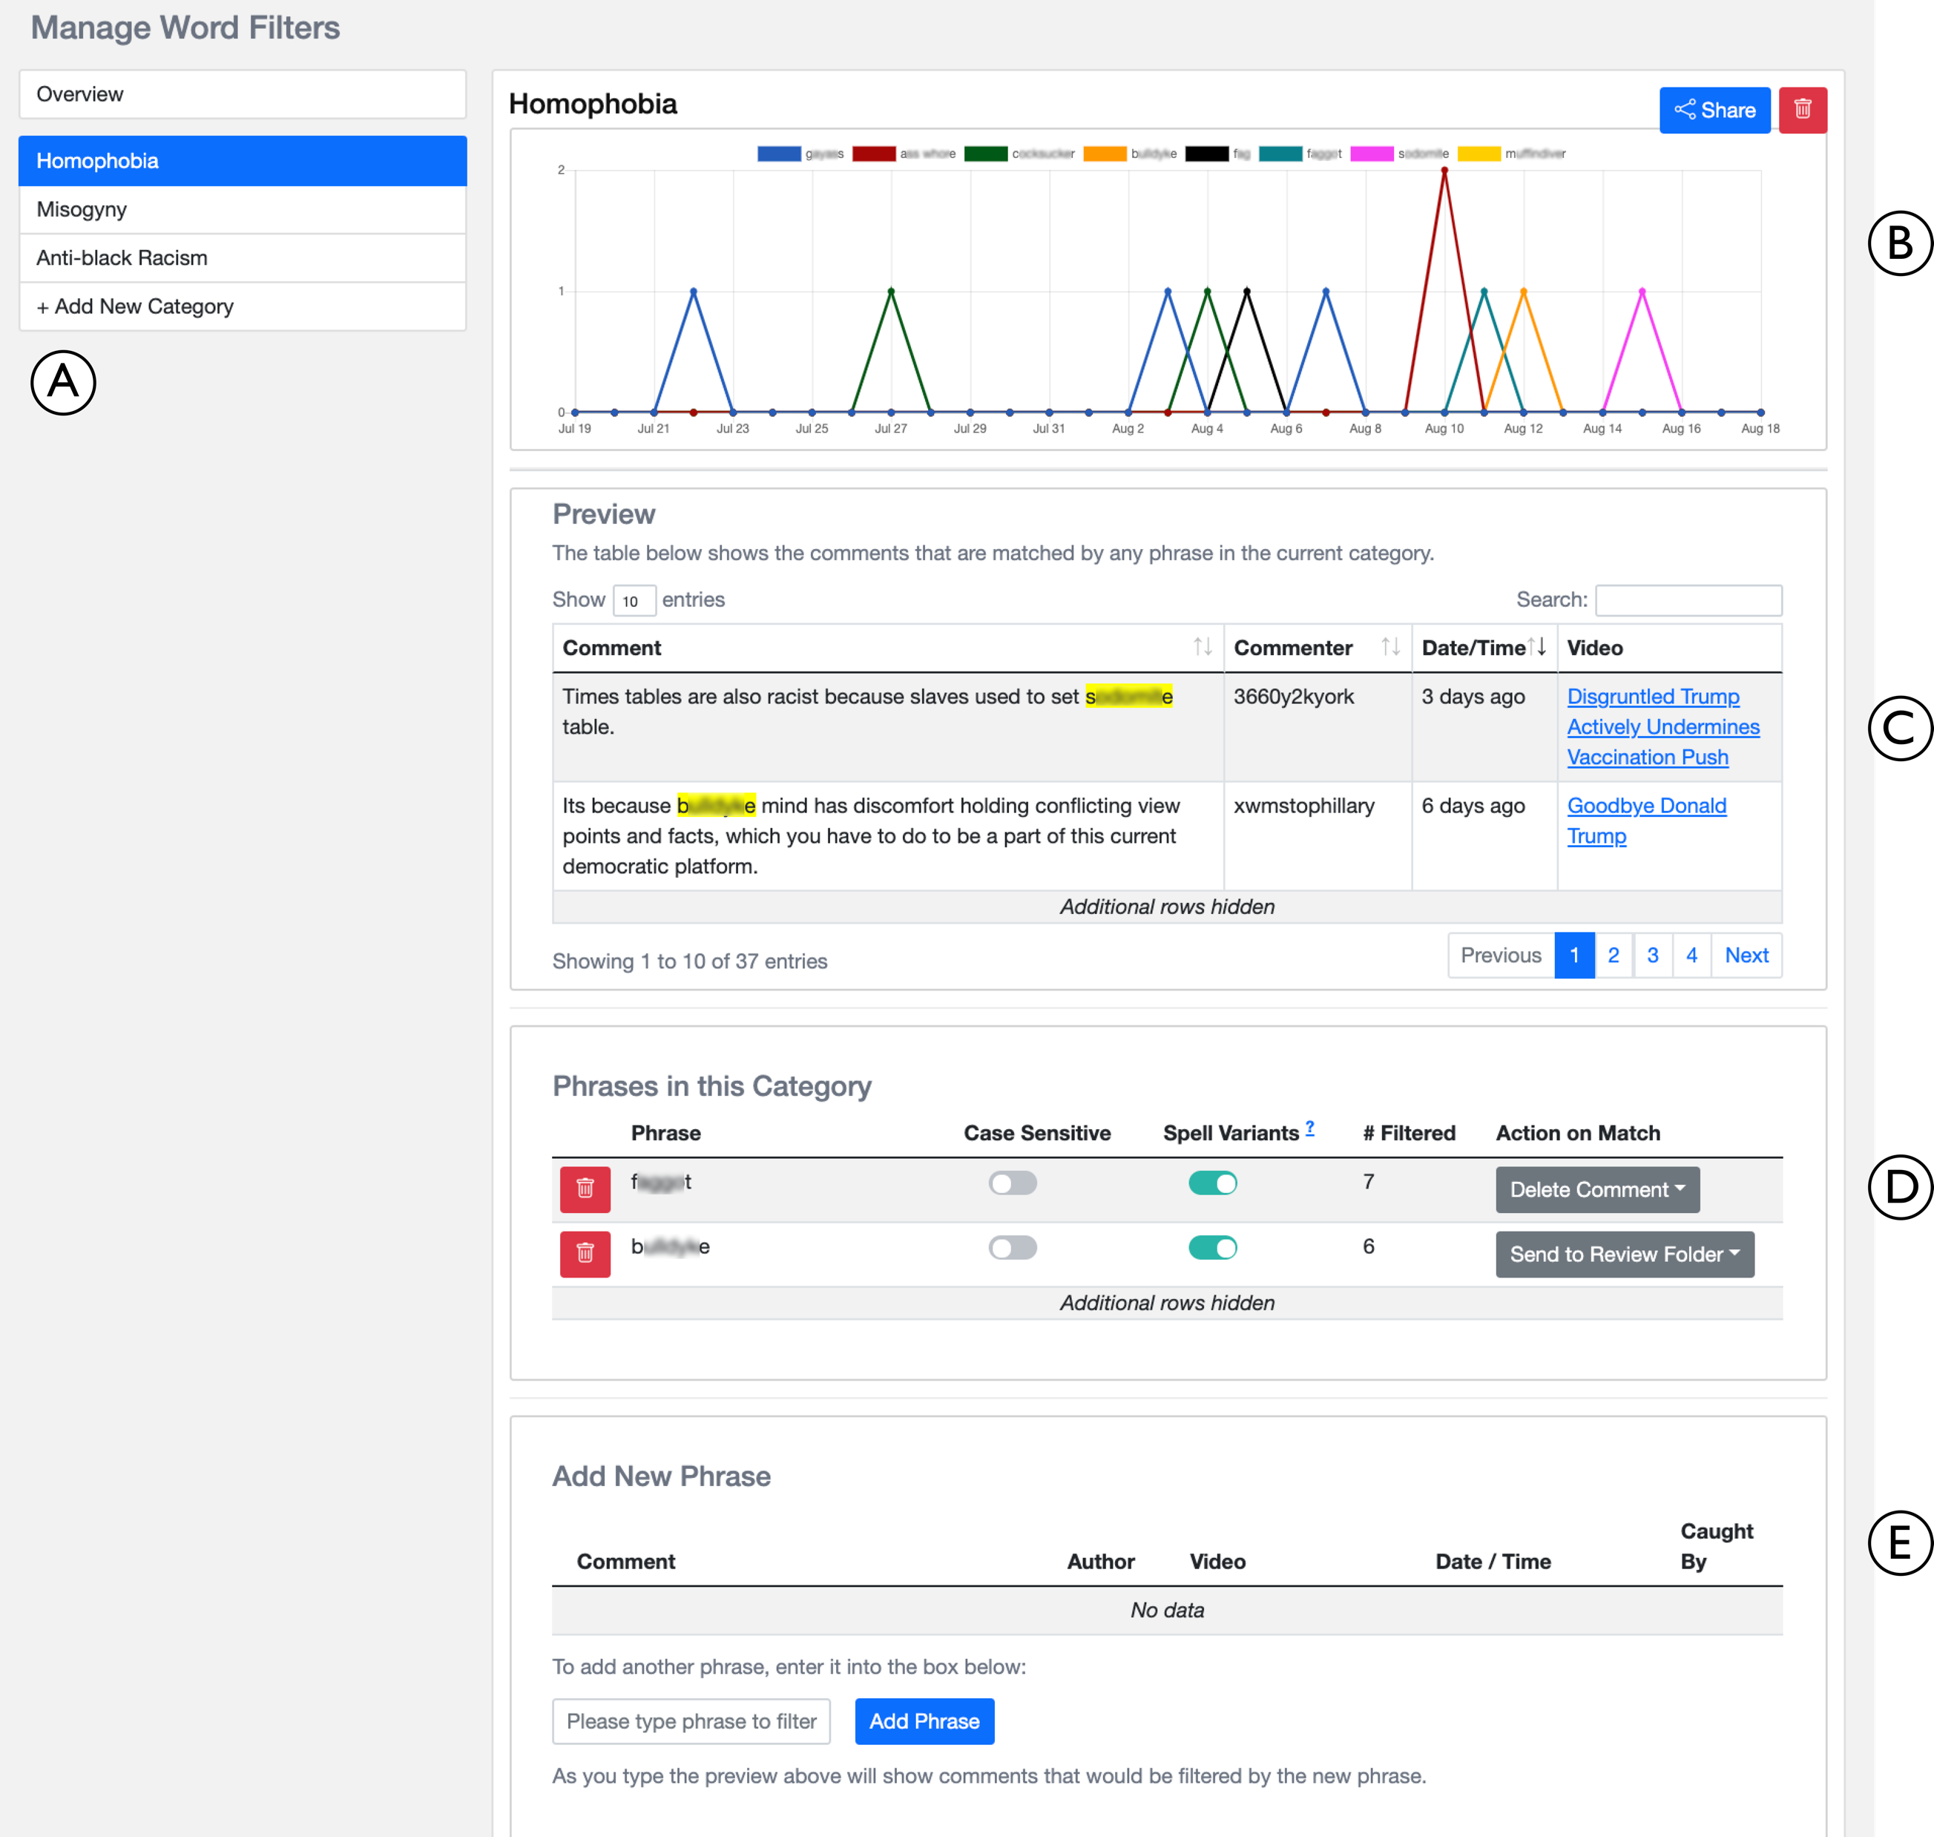
Notes:
To address this need, FilterBuddy allows creators to organize their word filters in several different categories.

Slide 14
Notes:
To address this need, FilterBuddy allows creators to organize their word filters in several different categories.
These are 3 examples of custom categories that a participant may configure in FilterBuddy

Slide 15
Need 2: Have a few default categories
Curated categories like sexism and racism
Avoid creating commonly needed categories from scratch
“Having the base list is perfect for the creator, because they don’t even have to like spend the time…brewing over what words might be used towards them, which is like the most messed up thing to have to think about in the first place” – U4
Notes:
Participants, especially those belonging to marginalized groups, wanted FilterBuddy to have a few curated categories available by default,
because they wanted to avoid creating commonly needed categories like sexism and racism from scratch.

Slide 16
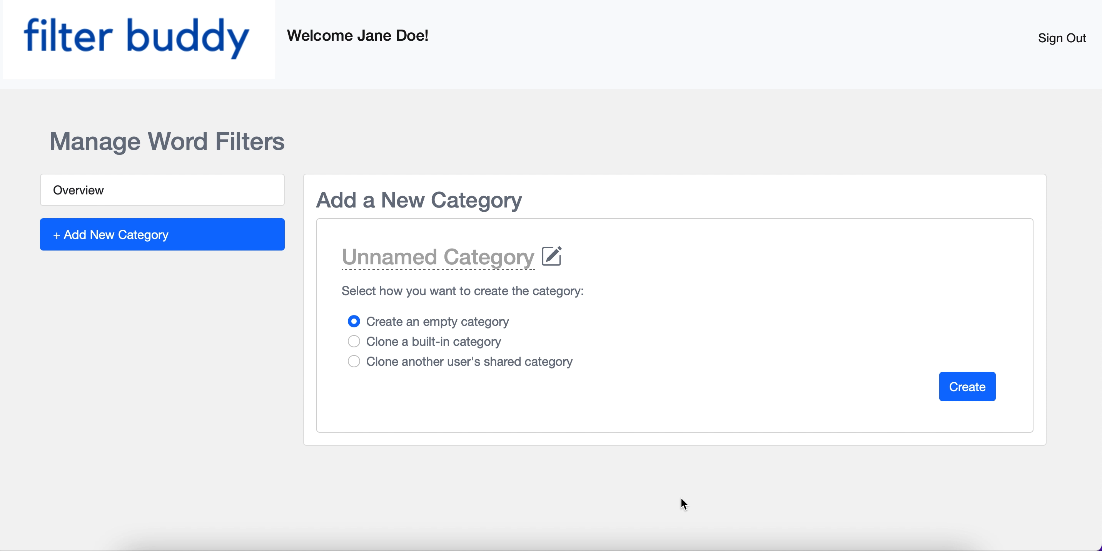
Notes:
[Pause]
To address this need, users can clone one of the built-in categories that FilterBuddy provides such as homophobia, physical violence, or sexual violence.
We have created filters for these categories ourselves based on prior literature.
Here, we are seeing how a user imports the built-in homophobia category.
On importing, users are redirected to a new homophobia category page that is already populated with many carefully curated homophobic keywords.
Users can subsequently edit this category to match their preferences.

